Slide 1

Optimizing Profit for the
Hershey Company
By: Alisha Barker, Jake Beder, Taylor Corbalis, Elijah Raffo, Johnny Whitaker

Slide 2

Layout
Introduction
Central Question
The Chocolate Making Process
Constraints
Cocoa
Milk
Machine Hours
Labor
Demand
Optimization
Results
Insights
Q&A
Notes:
alisha

Slide 3
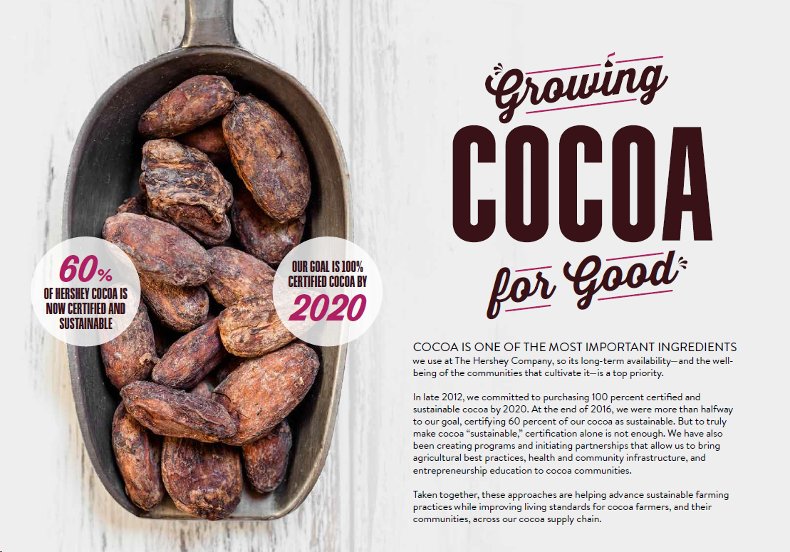

Slide 4
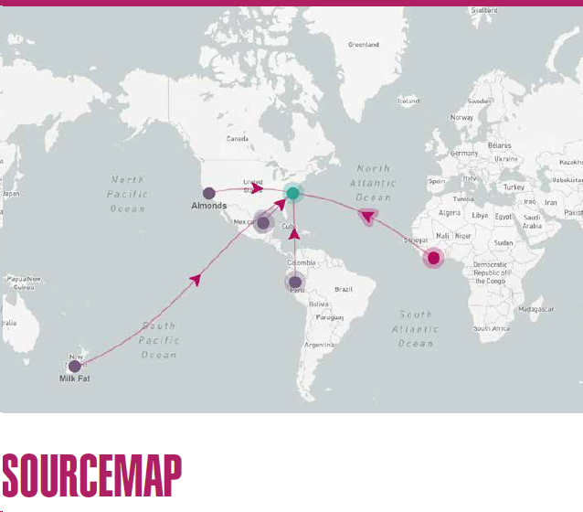

Slide 5
Central Question
Milk
Cocoa
Demand
Maximize the monthly profit of the Hershey’s Kiss department given weekly constraints

Slide 6
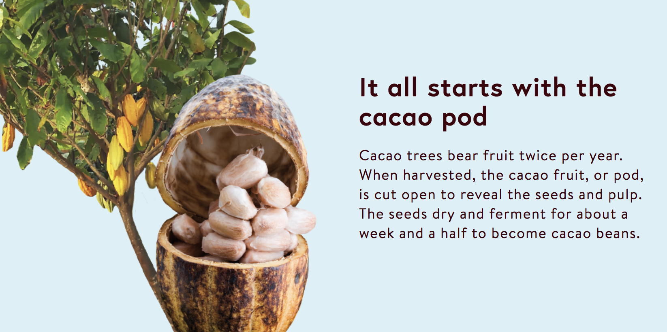
The Chocolate Making Process
Seeds dry and ferment (about 1.5 weeks)
Roasted to bring out flavor
Winnowed to get the nibs
Conching -> chocolate liquor
Notes:
https://www.hersheys.com/en_us/our-story/our-process.html

Slide 7
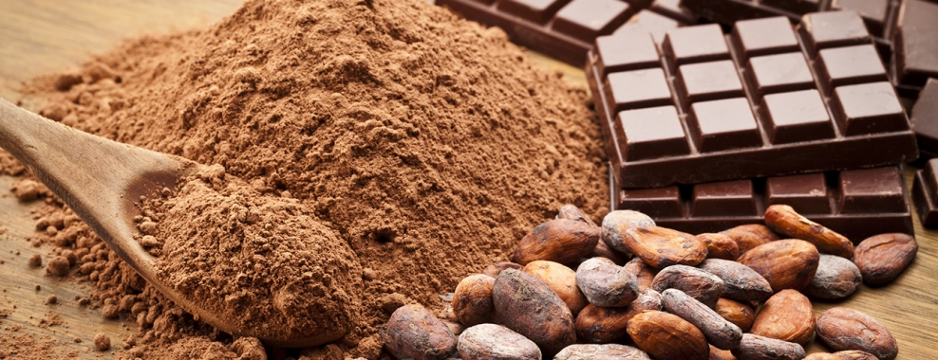
Cocoa
Organic Cocoa Proportionality
Currently set at 60%
Goal is 100% by 2020
Minimum and Maximum Cocoa Supply
The range of cocoa to be ordered to proportionally compliment milk supply

Slide 8

Locally Sourced Milk
Milk is mixed with sugar and condensed, then mixed with unsweetened chocolate
Variables: amount purchased weeks 1-4 & carryover inventory
Constraints: demand & supply
Notes:
Taylor
· Hershey’s milk chocolate is made with thousands of gallons of fresh milk delivered daily from farms within 200 miles of the factory in Pennsylvania. The milk is mixed with sugar and condensed before mixing it with unsweetened chocolate.
· We had a variable for milk that is the amount of milk to be purchased in weeks 1-4, and another variable for the amount of milk to be purchased in weeks 1-4 which exceeds demand for the week and is to be stored to use in another week’s production.
· One of our constraints was the demand of milk, which calculated the amount of milk needed to meet the demands of factory production, constrained to equal 0 so that no milk is wasted.
· Our other constraint for milk was the supply. This was the static order of milk required to produce enough to meet a tolerable level of product demand and order the minimum amount from the dairy farms where the milk is locally sourced. These local farmers are very dependent on the Hershey Company.
The range of milk to be ordered based on reported statistic and converted to reflect the solver’s narrow production focus

Slide 9
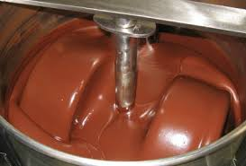
Machine Hours
Roast the beans for 35 minutes
Pick out the nibs (called winnowing)
Nibs are ground into chocolate powder
Mixed with milk and sugar
Next, conching begins to create chocolate (up to 16 hours)
Pour into molds and let dry
70 million Hershey’s Kisses per day

Slide 10

Constraints, Production & Resources
Machine Hours
Reflects total max production capacity
Hugs require 10% more machine hours
Labor Hours
Capacity of production workers
Converted into units of production
Notes:
Taylor
Machine Hours
Reflects the total max production capacity based on supply of Milk and Cocoa
Expressed in units of production to simplify equating to production
Hugs require 10% more machine hours to roughly simulate the extra resources required to create the White Chocolate ‘Hug’
Labor Hours
Reflects the capacity of production workers to intake raw cocoa in lbs
Converted into units of production to simplify equating to production

Slide 11

Demand
The demand for Kisses & Hugs are based off an estimate of weekly production capacity with fluctuating demand across the weeks of the month to simulate realistic commercial variability
Other demands such as cocoa, milk, and milk chocolate are based off the estimates of total factory production capacity
Whatever amount that exceeds the weekly demand carries over and is stored to be used in a later’s week production
Notes:
alisha
For the constraint of demand for Hugs & Kisses are based off an estimate of weekly production capacity with fluctuating demand across the 4 weeks within a month to simulate a realistic commercial variability

Slide 12


Constraints - Product Demand
95%
5%
Notes:
alisha (constraints - product demand)
Total Demand
Calculated by multiplying total daily Kisses production by proportion of Kisses and Hugs products which the model incorporates
Fluctuates across the weeks of the month to simulate realistic commercial variability
Demand Kisses
Accounts for 95% of demand amongst all Kisses and Hugs products
Demand Hugs
Accounts for 5% of demand amongst all Kisses and Hugs products

Slide 13

Maximize
Monthly Profit
Subject To
Four Weeks of Constraints
Projected Profit
Interpret Results

Slide 14
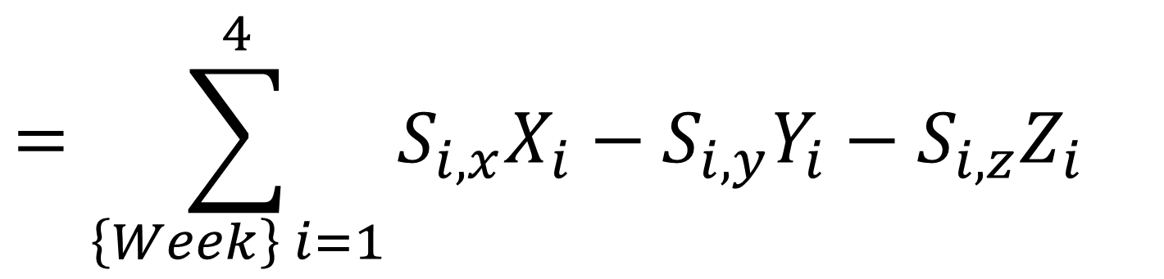
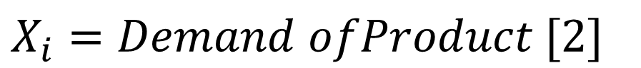
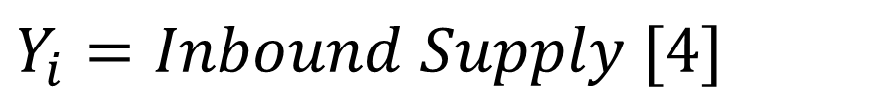

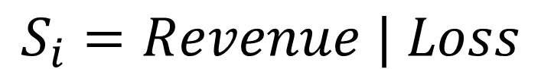
$$S_{i}=Revenue | Loss$$

Slide 15
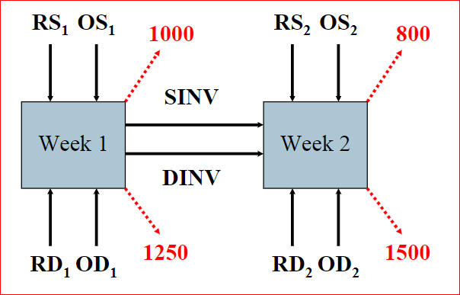
All Cocoa (W1)
All Cocoa (W2)
Kiss (W1)
Kiss (W2)
Cocoa Carry Over (W4)
Cocoa Carry Over (W1)
Demand & Constraints (W1)
Demand & Constraints (W2)
Milk Chocolate Carry Over (W1)
Milk Chocolate (W1)
Carry Over Kiss (W1)
Carry Over Kiss (W2)
Milk Chocolate Carry Over (W4)
Milk Chocolate (W2)
Graph Credit Prof. Ben

Slide 16
Constraints - Production - Input Demand
Demand Cocoa, Demand Milk & Demand Milk Chocolate
Calculates resource needs based on units produced
Constraint is set to equal 0 so that no product is wasted
Can be adjusted to reflect waste goals
Notes:
alisha

Slide 17
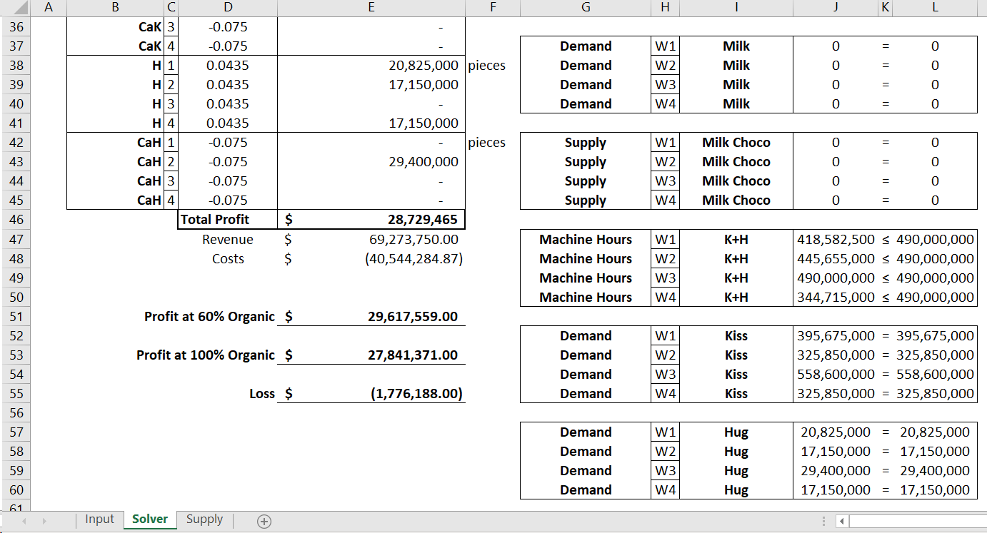

Slide 18
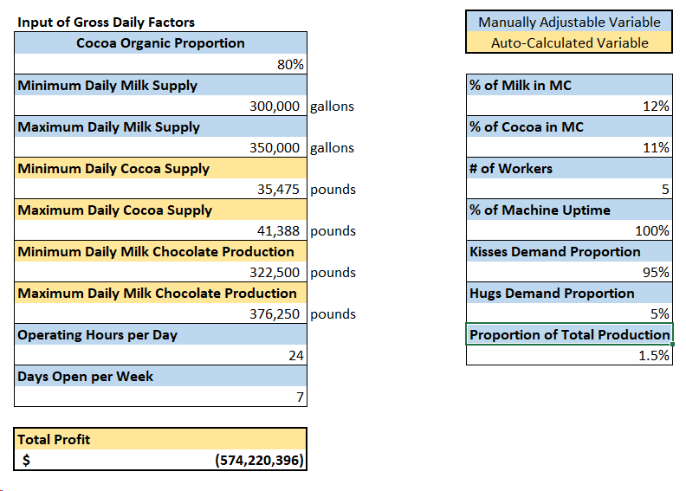

Slide 19


Slide 20


